Slide 1


Touch Sense Library for STM32F0

Slide 2
Agenda
Presentation
Time
What do I need to get it done?
How does it work?
Getting Started
Hands-on
8:30 – 10:00

Slide 3
What do I need to get it done?

Slide 4
API – STMTouch Library
We have one API for download:
32F0-TOUCH-LIB |  | MCUs Embedded Software | STM32F0 STMTouch library

Slide 5
References
For more details, please refer to following sources
AN4299 - Guidelines to improve conducted noise robustness on touch sensing applications
AN4310 - Sampling capacitor selection guide for MCU based touch sensing applications
AN4312 - Guidelines for designing touch sensing applications with surface sensors
AN4316 - Tuning a STMTouch-based application
Notes:
For more details, please refer to application notes AN4299, AN4310, AN4312 and AN4316.
Thank you.

Slide 6
How does it works?

Slide 7
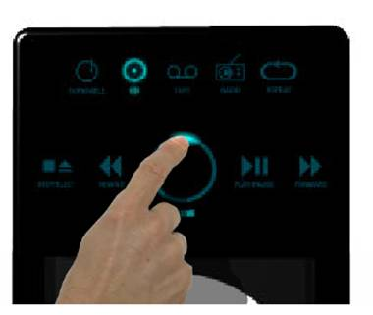
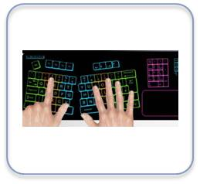
Overview
Provides a robust capacitive sensing technology
Surface charge transfer acquisition principle
Up to 24 capacitive sensing channels
Fully configurable
Reduced BOM
Pleasant and user-friendly interface
Reliable touch buttons thanks to a sealed environment
No need for mechanical parts
Application benefits
Notes:
Over recent years, Touch Sensing has become quite common in many applications such as mobile phones, induction cooktops and ovens, coffee machines, etc. This type of interface is more flexible and reliable compared to standard push buttons because mechanical parts are no longer needed.
The Touch Sensing Controller (TSC) embedded in STM32L4 devices offers a simple way to manage such interfaces. The TSC supports a robust charge transfer acquisition principle with up to 24 capacitive sensing channels. It is fully configurable and only a few external components are required to design a user-friendly interface.

Slide 8
Key features
Proven and robust surface charge transfer acquisition principle available on several STM32 MCU series
Supports up to 24 capacitive sensing channels split over 8 analog I/O groups
Number of channels and analog I/O groups depends on the MCU used
Up to 8 capacitive sensing channels can be acquired in parallel offering a very good response time
One sampling capacitor for up to 3 capacitive sensing channels to reduce system components
Full hardware management of the charge transfer acquisition sequence with spread spectrum to improve system robustness in noisy environments
Designed to operate with the free STM32Cube touch sensing library available in the corresponding STM32Cube package
Enhanced processing features for optimized sensitivity and immunity
Compatible with proximity, touchkey, linear and rotary touch sensors
Notes:
The key features of the Touch Sensing Controller are:
Proven and robust charge transfer acquisition principle which is available on several STM32 MCU series (STM32F0, STM32F3, STM32L0 and STM32L4).
Supports up to 24 capacitive sensing channels which are split over 8 analog I/O groups. The number of channels and I/O groups depends on the selected MCU.
For optimum performance, up to 8 capacitive sensing channels can be acquired in parallel. This offers a very good response time.
Only one sampling capacitor is needed to manage up to 3 capacitive sensing channels. This ensures a reduced BOM.
The charge transfer acquisition is fully managed by hardware to reduce CPU overhead. A spread spectrum feature is available to improve system robustness in noisy environments.
Finally, the Touch Sensing Controller is designed to operate with the free STM32Cube touch sensing library available in the corresponding STM32Cube package. This library offers all the processing required to develop a robust capacitive sensing solution and supports proximity, touchkey, linear and rotary touch sensors.

Slide 9
Block diagram
SYNC
Clock prescaler
Pulse generator
I/O control logic
G1_IO1
f_{HCLK}
G1_IO2
Spread spectrum
G1_IO3
G1_IO4
Group counters
Interrupt
TSC_IOG1CR
Gx_IO1
TSC_IOG2CR
Gx_IO2
Gx_IO3
Gx_IO4
TSC_IOGxCR
Notes:
To offer sufficient clock granularity, the TSC is directly clocked using the AHB clock. This clock is used by the spread spectrum block while the clock feeding the pulse generator is reduced using a prescaler. GPIOs supporting touch sensing must be configured in an alternate mode in order to connect them to the Touch Sensing Controller. The SYNC input pin is used to synchronize the capacitive sensing acquisition with an external stimulus without the need for CPU interaction. One counter per analog I/O group is used to store the result of the acquisition. An interrupt can be generated upon the end of acquisition of all the enabled analog I/O groups or when an error is detected. This interrupt helps limit CPU overhead.

Slide 10
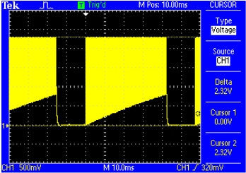
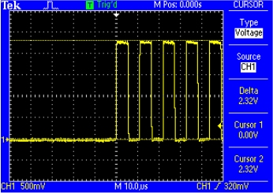
Charge transfer acquisition overview
Charge transfer uses electrical properties of the capacitor (charge Q)
The sensor capacitor (C_{X}) is charged to V_{DD}. Once it is fully charged, a portion of the capacitor’s charge is transferred to a sampling capacitor (C_{S}).
Charge is transferred using analog switches directly embedded into the GPIO
The charge transfer cycle is repeated N times until the voltage on the sampling capacitor reaches the V_{IH} threshold of the GPIO it is connected to
The number N of transfer cycles required to reach the threshold represents the size of C_{X}
The number of transfer cycles decreases when the sensor is touched.
Charge cycle
V_{IH}
V_{DD}
Electrode capacitor charging
Charge transfer
Notes:
The charge transfer acquisition technique works using the electrical properties of the capacitor. It consists in charging the sensor capacitor (C_{X}) to V_{DD}. Once this capacitor is fully charged, a part of the accumulated charge is transferred into a sampling capacitor (C_{S}). The number of charges transferred to the sampling capacitor depends on the factor C_{X}/C_{S}. The charge transfer cycle is repeated N times until the voltage on the sampling capacitor reaches a threshold (V_{IH} in our case). The number N represents the size of C_{X}.
When there is a touch, the sensor capacitor is increased and thus the amount of charge transferred from the sensor capacitor to the sampling capacitor is higher leading to a decrease in the number of charge transfer cycles.
The charge transfer is performed through analog switches embedded in the GPIO.

Slide 11
Charge transfer measuring circuit
R_{S} (typically 1 kΩ) is used to improve ESD robustness
C_{S} sampling capacitor value depends on the required channel sensitivity
The higher the C_{S} value is, the higher the sensitivity, but the longer the acquisition time
STM32 device
R_{S}
G1_IO1
G1_IO2
R_{S}
G1_IO3
R_{S}
G1_IO4
C_{X}(~20 pF)
C_{S}
Notes:
The measuring circuit is simple. Let’s consider one analog I/O group composed of four I/Os. One of these I/Os is the sampling capacitor I/O. It is connected to an external capacitor (C_{S}) commonly called the sampling capacitor. There is a single sampling capacitor per analog I/O group. The sampling capacitor value depends on the channel sensitivity. The higher the C_{S}, the higher the sensitivity and the longer the acquisition time.
The three other I/Os are dedicated to channels. Each of them is connected to a sensor electrode through a serial resistor (R_{S}). R_{S} is used to improve the ESD robustness of the application. Within one analog I/O group, only one channel is acquired at a time. This means that if three channels are implemented, three consecutive acquisitions will be required to get the image of the three sensors. For optimum performance, the sensor capacitance should be as low as possible. We often consider this capacitor value to be in the tens of picofarads. A touch leads to an increase in the sensor capacitance by a few picofarads, for example 5 picofarads.

Slide 12
Charge transfer acquisition sequence
S1
S2
S5
C_{X}
S4
S6
S4 is closed for the whole acquisition
S5 & S6 are open for the whole acquisition
S3
C_{S}
Step | S1 | S2 | S3 | Description
1 | Closed | Open | Closed | C_{S} & C_{X} discharge
2 | Open | Open | Open | Dead time
3 | Open | Closed | Open | Charge cycle (C_{X} charge)
4 | Open | Open | Open | Dead time
5 | Closed | Open | Open | Transfer cycle (charge transferred to C_{S})
6 | Open | Open | Open | Dead time
7 | Open | Open | Open | Read voltage on Cs
IO register
Repeat until V_{CS} is read as a logical ‘1’
Notes:
The charge transfer acquisition sequence is composed of 7 steps.
First, the sampling capacitor and the sensor capacitor are discharged to get a stable starting point by closing the analog switch S1 and enabling S3. Between each major step, an intermediate step is inserted to avoid an acquisition artifact. This step, called dead time, consists of opening all active analog switches and disabling all active transistors.
Next, the sensor capacitor (C_{X}) is charged to V_{DD} by closing S2.
After the dead time, a portion of the charge accumulated in C_{X} is transferred into the sampling capacitor C_{S} by closing the analog switch S1.
Once the charge is transferred, the voltage on C_{S} (V_{CS}) is read. If the voltage is lower than V_{IH}, a logical ‘0’ is returned. If it is greater than V_{IH}, a logical ‘1’ is read. If the returned logical value is ‘0’, Steps 3 to 7 are repeated. After each charge transfer loop, a counter is incremented, representing the capacitance of the sensor.

Slide 13
I/O configuration
Sampling capacitor I/O is configured as
Alternate output open-drain mode with Schmidt trigger hysteresis disabled
Channel I/O is configured as
Alternate output push-pull mode
Notes:
In order for a Touch Sensing GPIO to be controlled by the TSC:
- A sampling capacitor I/O must be configured in alternate output open-drain mode. In addition, to avoid artifacts, the Schmidt trigger hysteresis must be disabled.
- A channel I/O must be configured in alternate output push-pull mode.

Slide 14
Acquisition modes
Flexible acquisition modes to reduce CPU load
Normal acquisition mode
Once the TSC peripheral is configured, the acquisition is launched by setting the START bit of the TSC_CR register
Synchronized acquisition mode
Once the TSC peripheral is configured, the acquisition is launched upon the detection of a falling or rising edge and a high level on the SYNC input pin
This mode is useful to limit the effect of noise in some applications (induction cooktop, …)
In both modes, the end of acquisition and/or max count error can be managed by polling or interrupt
Notes:
To reduce the CPU load, two acquisition modes are supported:
Normal acquisition mode where the acquisition starts by setting the START bit of the TSC_CR register.
Synchronized acquisition mode where the acquisition only starts upon the detection of a falling or rising edge and a high level on the SYNC input pin. This mode is useful to limit the effect of noise in some applications such as an induction cooktop.
In both modes, the end of acquisition and/or max count error can be managed either by polling or interrupt.

Slide 15
GPIO analog switch and hysteresis control
Flexible and versatile GPIOs
The touch sensing controller also provides a manual control for both the embedded analog switch and hysteresis of GPIOs belonging to analog I/O groups
This could be useful for implementing a different capacitive sensing acquisition principle or for other purposes (i.e. analog multiplexor).
Notes:
In addition to manageming the charge transfer capacitive acquisition principle, the TSC peripheral allows the designer to individually control the analog switch and Schmidt trigger hysteresis of I/Os belonging to analog I/O groups. This capability could be useful to implement a different capacitive sensing acquisition principle or for other purposes such as an analog multiplexer.

Slide 16
Interrupts
Interrupt event | Description
End of acquisition | Set when an acquisition is completed.
Max count error | Set when a max count error occurs. The management of the max count error avoids getting into an infinite acquisition in case of channel issues (C_{S} in short-circuit, …).
Notes:
The TSC peripheral offers two interrupt sources:
- End of acquisition which notifies the CPU when all the active channels are acquired.
- Max count error which is set when the acquisition fails on one or several channels. It is useful in preventing an infinite acquisition which can occur in the event of a hardware failure.

Slide 17
Low-power modes
Mode | Description
Run | Active.
Sleep | Active. Peripheral interrupts cause the device to exit Sleep mode.
Low-power run | Active.
Low-power sleep | Active. Peripheral interrupts cause the device to exit Low-power sleep mode.
Stop 1 | Frozen. Peripheral registers content is kept.
Stop 2
Standby | Powered-down. The peripheral must be reinitialized after exiting Standby or Shutdown mode.
Shutdown
Notes:
The touch sensing controller is active in Run, Sleep, Low-power run and Low-power sleep modes. This means that charge transfer acquisition can only be performed in these modes. In all others modes (Stop 1, Stop 2, Standby and Shutdown), the touch sensing controller is not operational. In Stop modes, the peripheral is frozen but the registers content is kept. In Standby and Shutdown modes, the registers content is lost and the peripheral must be reinitialized.

Slide 18
Number of capacitive sensing channels
Analog I/O group | Number of capacitive sensing channels
 | STM32L486Zx STM32L486Qx STM32L476Zx STM32L476Qx STM32L471Zx STM32L471Qx | STM32L486Vx STM32L476Vx STM32L471Vx | STM32L486Jx STM32L486Rx STM32L476Jx STM32L476Rx STM32L471Jx STM32L471Rx
G1 | 3 | 3 | 3
G2 | 3 | 3 | 3
G3 | 3 | 3 | 0
G4 | 3 | 3 | 3
G5 | 3 | 3 | 0
G6 | 3 | 3 | 0
G7 | 3 | 3 | 3
G8 | 3 | 0 | 0
Number of capacitive sensing channels | 24 | 21 | 12
Notes:
This table lists the number of capacitive sensing channels depending on the STM32L4 device.

Slide 19
Getting Started

Slide 20
STMTouch touch sensing library
Supported microcontrollers and dev. Tools
Any STM32 microcontroller using the embedded touch sensing controller (TSC):
STM32F0 series, STM32F3 series, STM32L0 series and STM32L4 series:
Surface charge-transfer acquisition principle managed by the touch sensing controller
Up to 24 channels (8 groups of 3 channels maximum)
Up to 8 channels can be acquired simultaneously
Spread spectrum feature
Programmable charge transfer frequency and max count value
• STM32L1 series microcontrollers:
Surface charge-transfer acquisition principle managed by: – Two timers + routing interface (hardware acquisition mode). This mode is not supported on STM32L1 series microcontrollers featuring 256 K or less memory.
GPIOs + routing interface (software acquisition mode). This mode is supported by all microcontrollers. – Up to 34 channels – Up to 11 channels can be acquired simultaneously
Development Tools:
EWARM
MDK-ARM
SW4STM32

Slide 21
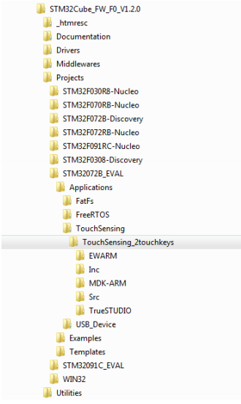
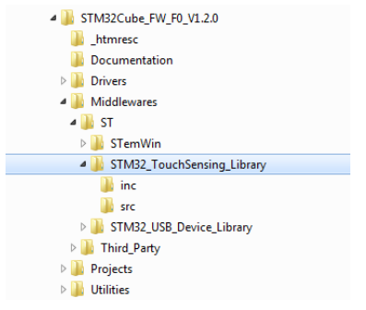
Package Description
Images from Cube Repository

Slide 22
Main Features
Supports proximity, touchkeys, linear and rotary touch sensors
Environment Change System (ECS)
Detection Time Out (DTO)
Detection Exclusion System (DXS)
Noise filter
Unlimited number of sensors **
The maximum number of channels is only limited by the device (memory size and channels supported).
Modular architecture allowing easy addition of new acquisitions or sensors
Each sensor can have its own state machine
Simplified timing management / Management of error during acquisition

Slide 23
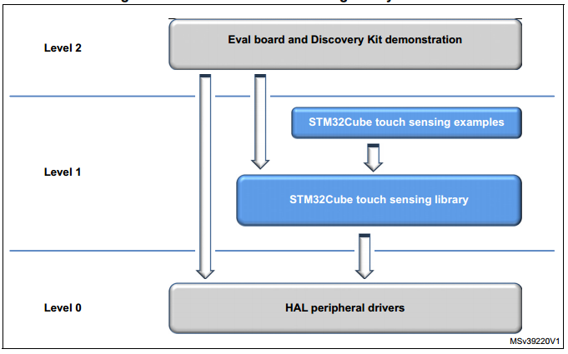
Architecture

Slide 24
Touch sensing library layers
Application
layer
User application
STM32Cube touch sensing library
configurationfile
DTO
DxS
Timing
Processing
layer
ECS
Filters
…
STM32Cube touch sensing
library
TouchKey
sensor
Linear and rotary
sensors
…
Acquisition
layer
Acquisition
MCU 1
Acquisition
MCU 2
…
Notes:
The STM32Cube touch sensing library is composed of several modules. The library relies on the corresponding STM32 series HAL and it is configured through a dedicated configuration file. Once included into your project, the STM32Cube touch sensing library is part of the overall application and each C function can be launched to get the appropriate behavior.
For further details on the STM32Cube touch sensing library, please refer to the corresponding user manual.

Slide 25
STMTouch library layers
The STMTouch touch sensing library is composed of three main layers:
The acquisition layer
The processing layer
The configuration layer
The configuration layer corresponds to what the user needs to write in its application code in order to use correctly the STMTouch touch sensing library. This includes all the channels and sensors declaration, the parameters, etc...so here is were will add our code!

Slide 26
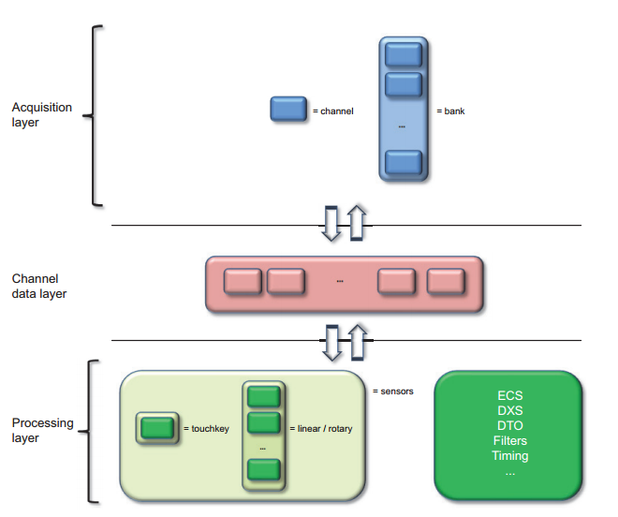
Acquisition and Processing Layers

Slide 27
Acquisition and Processing Layers
The acquisition layer role is to perform the acquisition of the different channels. The result of the acquisition (measure and flags) is stored inside the channel data layer. These information will be accessed by the processing layer. The acquisition layer has only access to the channels and banks. It does not have access to the sensors

Slide 28
Acquisition and Processing Layers
The channel data layer role is to share information between the acquisition and processing layers. It stores the result of the acquisition (measure) for each channel and store different informations coming from the processing layer (reference, delta, flags, etc...).
Located in RAM, the ChannelData structure is the only interface between the acquisition and processing layers

Slide 29
Acquisition and Processing Layers
This processing layer consists in executing each sensors state machine, executing the different data processing like ECS, DXS, DTO and storing any useful information for the acquisition layer inside the channel data area. The processing layer does not have direct access to the channels and banks. This access is made through the sensors

Slide 30
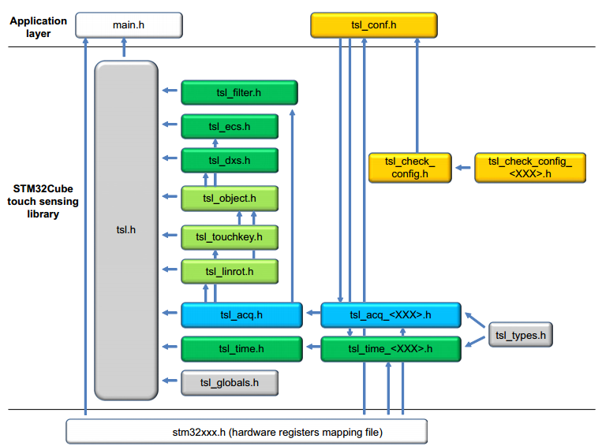
Header files inclusion

Slide 31
Channel
A channel is the basic element that is used to store several information like:
where the source measurement can be found after the acquisition is performed (i.e. TSC_IOGxCR registers for TSC acquisition).
where are stored the measure, the reference, the delta, flags etc...
Resources - a channel is defined by 3 data structures:
TSL_ChannelSrc_T: contains all information about the source measurement (index of the register containing the measurement, masks,...)
TSL_ChannelDest_T: contains all information about the measurement destination (index in the channel data array).
TSL_ChannelData_T: contains all data for the channel (measure, delta, reference, ...)
The channel depends on the acquisition technology, so each have their own header, in our case, it’ll be tsl_acq_tsc.h

Slide 32
Channel
Parameters
TSLPRM_TOTAL_CHANNELS
Usage example: the 3 channels structures must be declared in the application code
Example of channel source array declaration for microcontrollers featuring TSC peripheral. This structure must always be placed in ROM.
Example of channel destination array declaration for microcontrollers featuring TSC peripheral. This structure must always be placed in ROM.
const TSL_ChannelSrc_T MyChannels_Src[TSLPRM_TOTAL_CHANNELS] =
{ { CHANNEL_0_SRC },
{ CHANNEL_1_SRC },
{ CHANNEL_2_SRC }};
const TSL_ChannelDest_T MyChannels_Dest [TSLPRM_TOTAL_CHANNELS] =
{ { CHANNEL_0_DEST },
{ CHANNEL_1_DEST },
{ CHANNEL_2_DEST }};

Slide 33
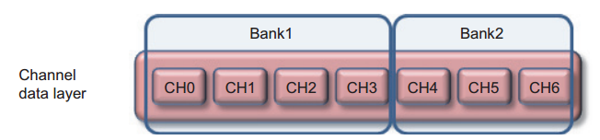
Channel
Same example continued:
Example of channel data array declaration (i.e. channel data layer). This structure must always be placed in RAM.
When several banks are present, it’s mandatory to declare all channels of each bank consecutively in the source and destination structures
TSL_ChannelData_T MyChannels_Data[TSLPRM_TOTAL_CHANNELS];

Slide 34
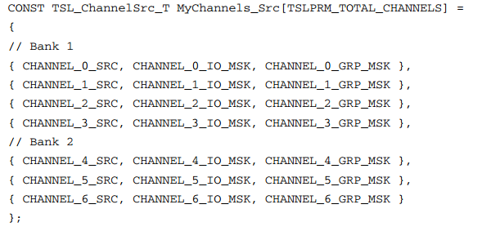
Channel
Declaration array should be like this:

Slide 35
Bank
A bank is a group of channels that are acquired simultaneously. The number of channels in the bank is variable
Resources – the bank data are held by only one structure:
TSL_Bank_T
The bank depends also on the acquisition technology. These structures are declared in each acquisition header files (tsl_acq_.h)
Parameters
TSLPRM_TOTAL_BANKS

Slide 36
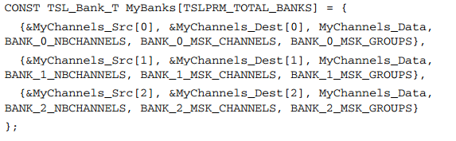
Bank
Usage example - Example of 3 banks declaration for microcontrollers featuring TSC peripheral:

Slide 37
Objects
The object, also known as sensor stads for any type of sensor (touchkey, linear and rotary) supported by the touch sense library
Resource, alll processing that affect the sensors in general are defined in:
tsl_object.c
tsl_object.h The functions are:
TSL_obj_GroupInit()
TSL_obj_GroupProcess()
TSL_obj_SetGlobalObj()
A sensor is described by the structures:
TSL_Object_T
TSL_ObjectGroup_T
Parameters:
TSLPRM_TOTAL_OBJECTS

Slide 38
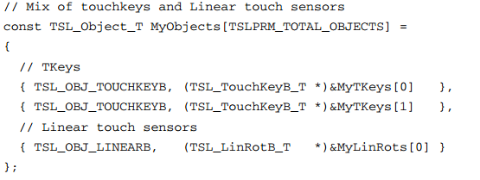
Objects
Usage example: First, all touchkeys, linear and rotary touch sensors (described after) used in the application must be described first as 'generic' sensor or object.
These object must be placed in ROM memory

Slide 39
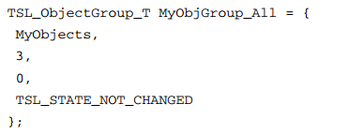
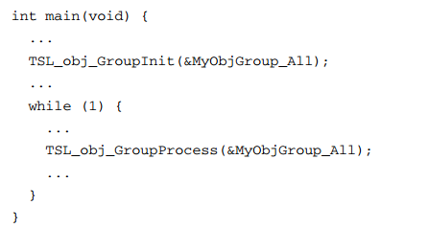
Objects
Once this done, it is necessary to create at least one group of sensors. These groups will be used by the different processing routines (ECS, DXS, etc...).
These object must be placed in RAM memory and then they need to be initialized and processed

Slide 40
Touchkey Sensor
The touchkey sensor is composed of only one channel. It acts as a simple “button” with two states RELEASE and DETECT (or TOUCH if DXS is enabled).
Resources, all the functions related to this sensor are described in the files:
tsl_touchkey.c
tsl_touchkey.h T
Two types of touchkey sensor are available:
Basic: defined by the TSL_TouchKeyB_T structure
Extended: defined by the TSL_TouchKey_T structure
Two functions (called methods) are used to initialized the sensor parameters and to run the sensor state machine:
TSL_tkey_Init()
TSL_tkey_Process()

Slide 41
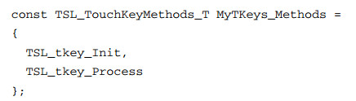
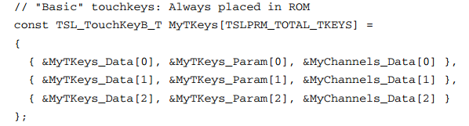
Touchkey Sensor
Parameter
TSLPRM_TOTAL_TKEYS
Example
“Basic” sensor:

Slide 42
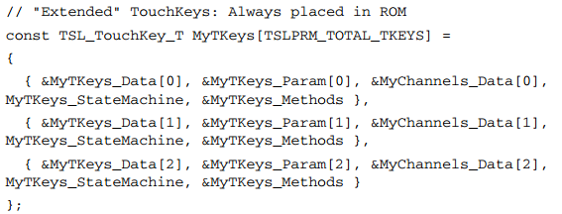
Touchkey Sensor
Example with “extended” sensor

Slide 43
Linear and rotary touch sensors
The linear and rotary touch sensors are like a touchkey sensor except that they are composed of a variable number of channels. The difference between the linear and rotary touch sensors is how the electrodes are organized together.
The linear and rotary touch sensors have additional fields in their structure compared to touchkey sensors:
Number of channels
Delta coefficient table
Position offset table
Sector computation parameter
Position correction parameter for linear sensor

Slide 44
Linear and rotary touch sensors
Number of channels
Only 1, 3, 4, 5 and 6 channels are supported today by the STMTouch touch sensing library. Additional number of channels can be added by the end-user.
Resources, all the functions related to this sensor are described in the files:
tsl_linrot.c
tsl_linrot.h
Two types of linear and rotary sensor are available:
basic: defined by the TSL_LinRotB_T structure
extended: defined by the TSL_LinRot_T structure
The difference between “basic” and “extended” is the same as for the touchkey sensor. Three functions (called methods) are used to initialized the sensor parameters, run the sensor state machine and calculate the position.
TSL_linrot_Init() • TSL_linrot_Process() • TSL_linrot_CalcPos()

Slide 45
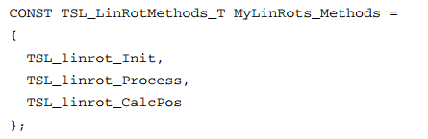
Linear and rotary touch sensors
Parameters:
TSLPRM_TOTAL_LINROTS
Usage example:
The declaration of the linear and rotary sensor is done by the user in the application code in the same manner as for touchkey sensor

Slide 46
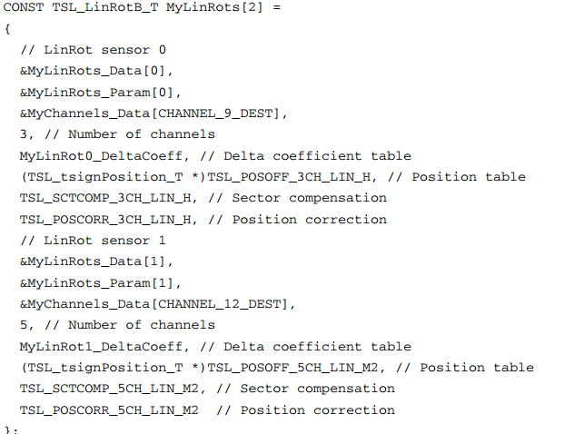
Linear and rotary touch sensors
Example: 2 “basic” linear touch sensors, one with 3 channels half-ended and the other with 5 channels mono electrodes design

Slide 47
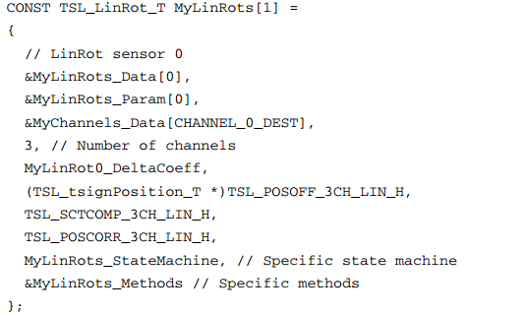
Linear and rotary touch sensors
Example: one “extended” (i.e. having its own state machine and methods) linear touch sensor with 3 channels half-ended

Slide 48
Main State Machine
The main state machine is managed by the user in the application layer. A set of functions are available to accomplish this task.
The main state machine can be defined with polling or with interrupt modes, using one or several banks.
The modularity of the STMTouch touch sensing library allows also the application code to be inserted between acquisition and processing tasks

Slide 49
Main State Machine
The functions to use for the acquisition are:
TSL_acq_BankConfig()
TSL_acq_BankStartAcq()
TSL_acq_BankWaitEOC()
TSL_acq_BankGetResult()
The functions to use for the processing are:
TSL_obj_GroupProcess()
TSL_ecs_Process()
TSL_dxs_FirstObj()

Slide 50
Main State Machine
Other functions that can be used during the processing:
TSL_tim_CheckDelay_ms()
TSL_obj_SetGlobalObj()
TSL_tkey_GetStateId()
TSL_tkey_GetStateMask()
TSL_linrot_SetStateOff()
TSL_linrot_SetStateCalibration()

Slide 51
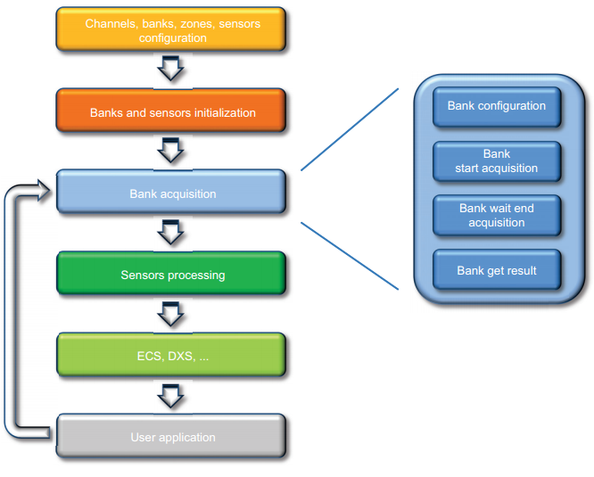
Main State Machine

Slide 52
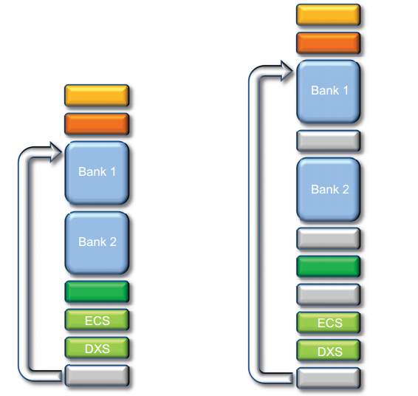
State Machine with 2 banks

Slide 53
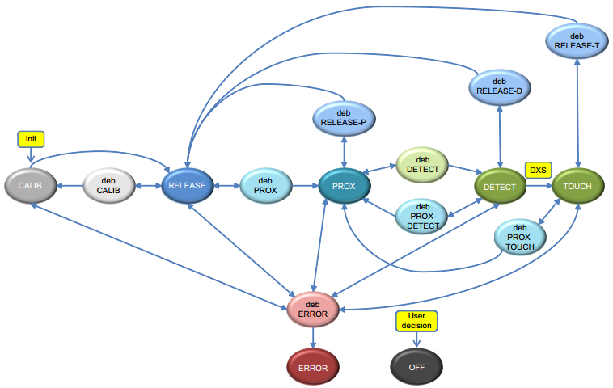
“Simplified” Sensor state machine

Slide 54
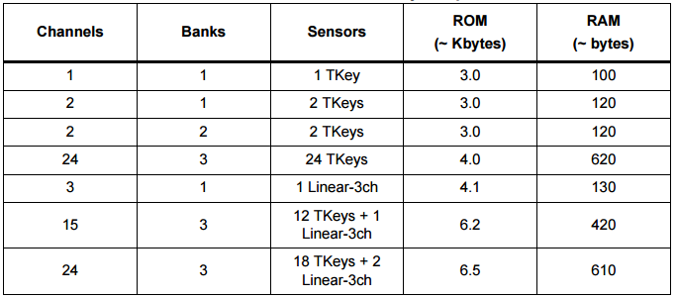
Memory Footprint
Compiler optimization: high size
Counted files: tsl*.o
STM32 TouchSensing library options: ECS=ON, DTO=ON, DXS=OFF, PROX=OFF
Each sensor has its own parameters placed in RAM

Slide 55
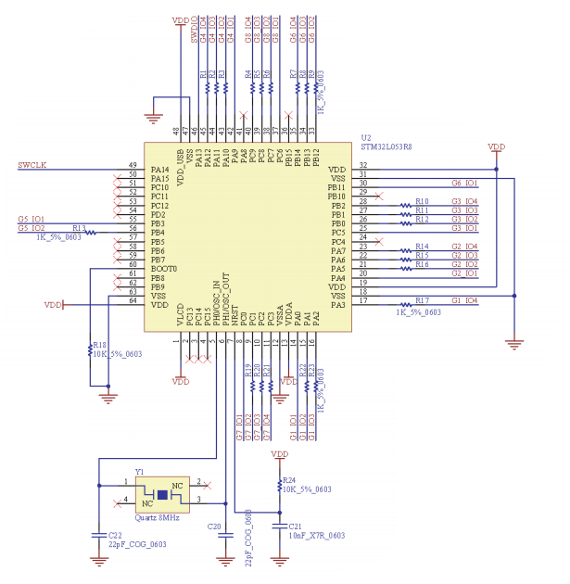

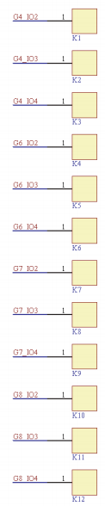
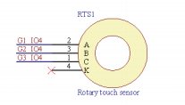
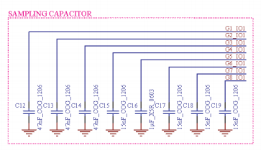
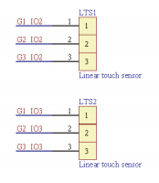
Hardware Example

Slide 56
Hands ON

Slide 57
Hands-On Session: Out-of-the-box

Slide 58

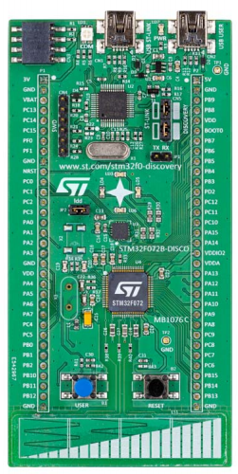
STM32F072 Discovery
Integrated ST-Link/V2-1 (for programming and debugging)
4 LEDs
Gyroscope
2 push buttons
Touch Sense Slider
58

Slide 59
STM32F072 Discovery
NFC / ACP connector
USB Device Connector
Direct access to all MCU I/Os
59

Slide 60
Go to TSL demo
By pressing 3 times the user button, the application will go to the TSL demo and use the slider to demonstrate a bar graph using the LEDs
Play a little ☺

Slide 61
Create your Application
Since CubeMX doesn’t add the Touch Sense Library yet, the easiest way to develop is to take an example that is close in term of number of channels/sensors with the mcu we’re targeting. Copy and paste the example in the same parent folder and rename it according to your application
Once this is done, we’ll need to modify the files, as described in the following slides

Slide 62
How to!?!
Toolcahin compiler:
The device that you intend to use must be written in the toolchain compiler preprocessor section of your project. These defines are the same as those used by the STM32Cube. Please see the stm<xxx>.h map file to have the list of the microcontrollers definition.
The tsl_conf.h file:
The tsl_conf.h file contains all the STMTouch touch sensing library parameters. The following edits must be done:
1. Change the number of channels, banks, sensors according your application.
2. Change the common parameters: thresholds, debounce, ECS, DTO, etc...
3. Change the parameters specific to the device
The main file:
The main.c and main.h files contain the application code itself (LEDs and LCD management, etc...) and the call to the STMTouch touch sensing library initialization and action functions.

Slide 63
How to!?!
The tsl_user file:
The tsl_user.c and tsl_user.h files contain the STMTouch touch sensing library configuration (definition of channels, banks, sensors, etc...) and the STMTouch touch sensing library initialization (TSL_user_Init) and action (TSL_user_Action) functions.
Create the channels variables using the structures (mandatory):
TSL_ChannelSrc_T
TSL_ChannelDest_T
TSL_ChannelData_T
Create the Banks variables using the structures (mandatory):
TSL_Bank_T
Create the touchkeys variables using the structures (optional):
TSL_TouchKeyData_T
TSL_TouchKeyParam_T
TSL_State_T •
TSL_TouchKeyMethods_T
TSL_TouchKeyB_T
TSL_TouchKey_T

Slide 64
How to!?!
The tsl_user file:
Create the linear and rotary touch sensors variables using the structures (optional):
TSL_LinRotData_T
TSL_LinRotParam_T
TSL_State_T
TSL_LinRotMethods_T
TSL_LinRotB_T
TSL_LinRot_T
Create the generic sensors (objects) variables using the structures (mandatory):
TSL_Object_T
TSL_ObjectGroup_T
The TSL_user_Init() function contains the initialization of the STMTouch touch sensing library. Modify this function to take into account your bank array name and object groups names.
The TSL_user_Action() function contains the main state machine. Modify it also if you have several object groups to process or to change the ECS period, etc..

Slide 65
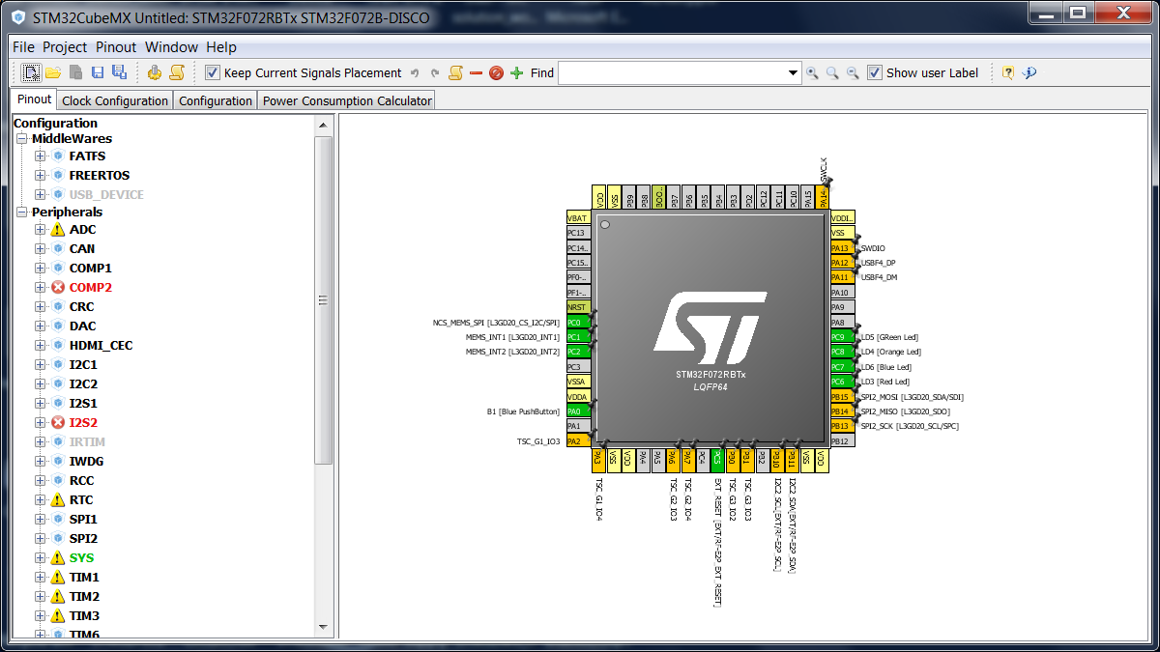
From Scratch ☺
Open CubeMX, select the New Project
Chose Board Selector > STM32F072B-DISCO

Slide 66
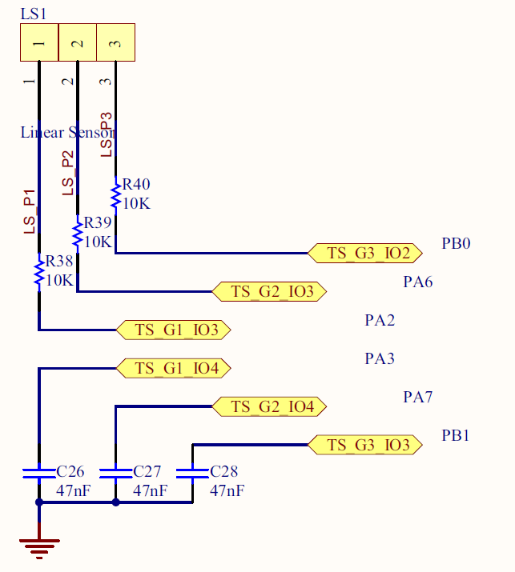
From Scratch
3 pairs of I/O ports are assigned to the linear touch sensor / touch keys. Each pair must belong to the same analog switch group:
PA2, PA3 (group 1)
PA6, PA7 (group 2)
PB0, PB1 (group 3)

Slide 67
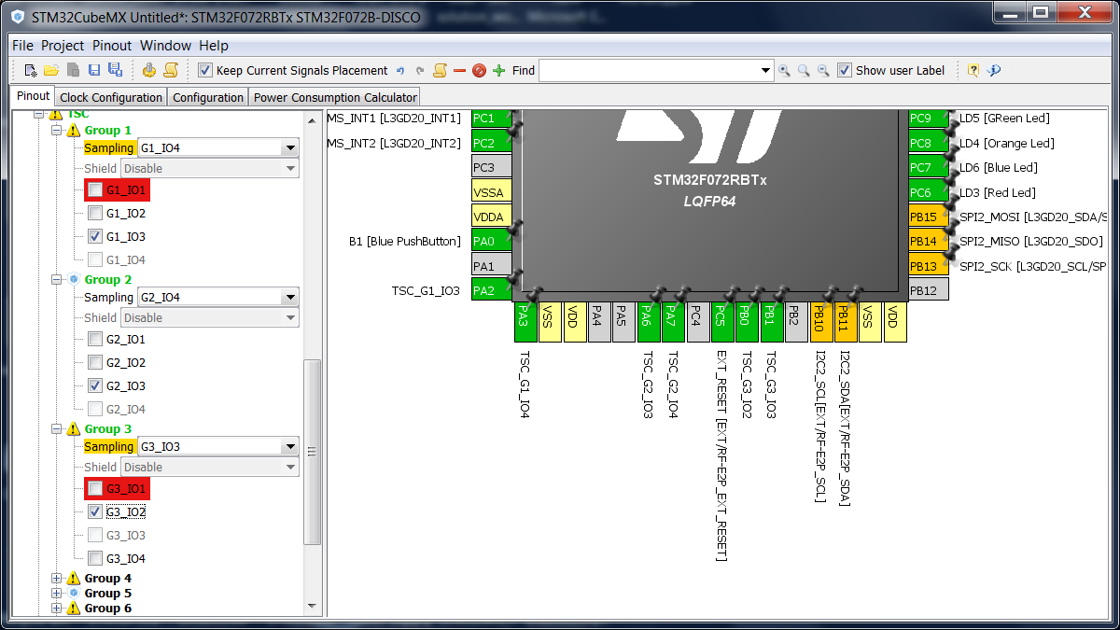
From Scratch
Configure Cube:

Slide 68
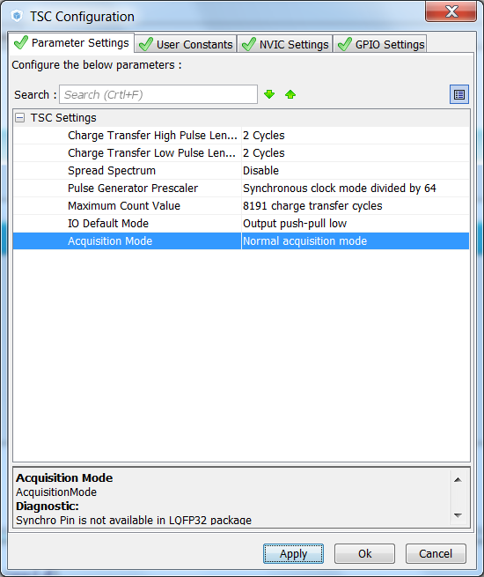
From Scratch

Slide 69
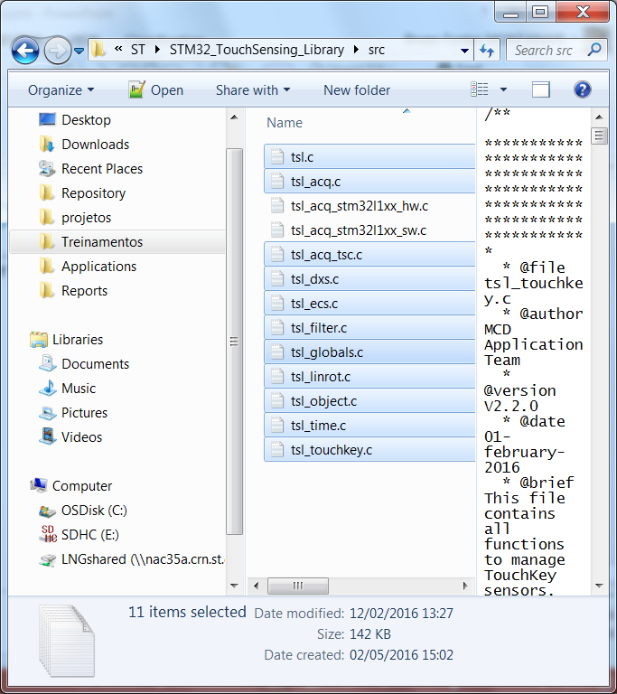
From Scratch
Let’s copy the middleware files:

Slide 70
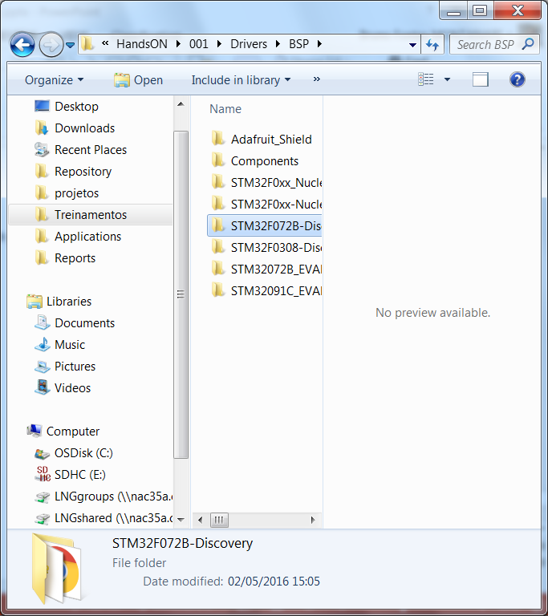
From Scratch
Let’s copy the BSP files:

Slide 71
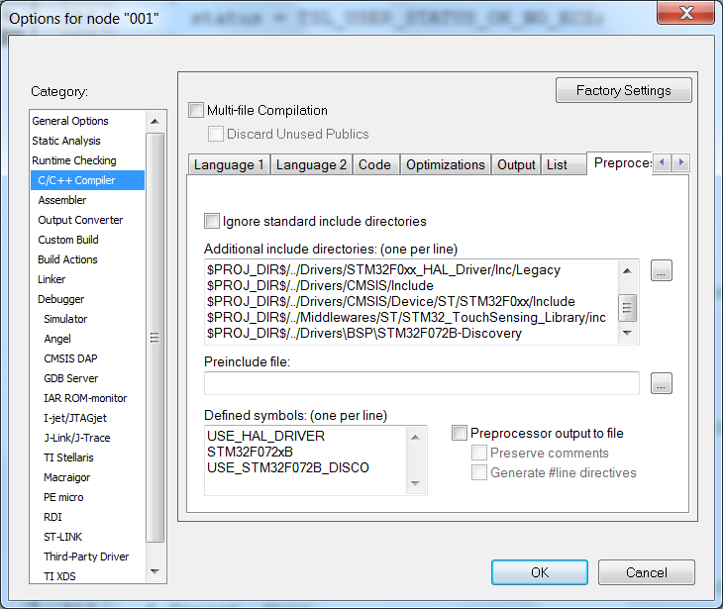
From Scratch
Preprocessor:
$PROJ_DIR$/../Middlewares/ST/STM32_TouchSensing_Library/inc
$PROJ_DIR$/../Drivers\BSP\STM32F072B-Discovery
USE_STM32F072B_DISCO

Slide 72
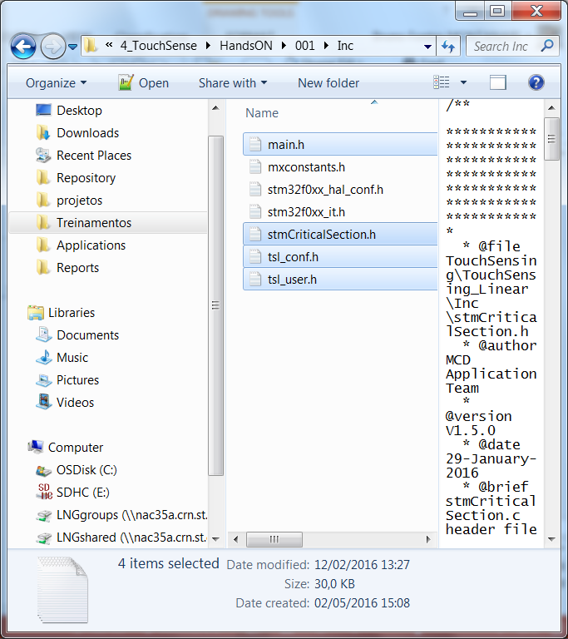
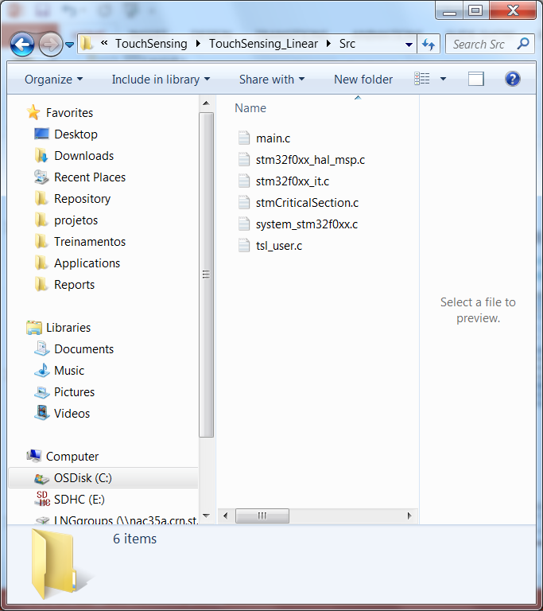
From Scratch
The example we’ll use is under the repository:
STM32Cube\Repository\STM32Cube_FW_F0_V1.5.0\Projects\STM32F072B-Discovery\Applications\TouchSensing\TouchSensing_Linear\Inc and Src

Slide 73
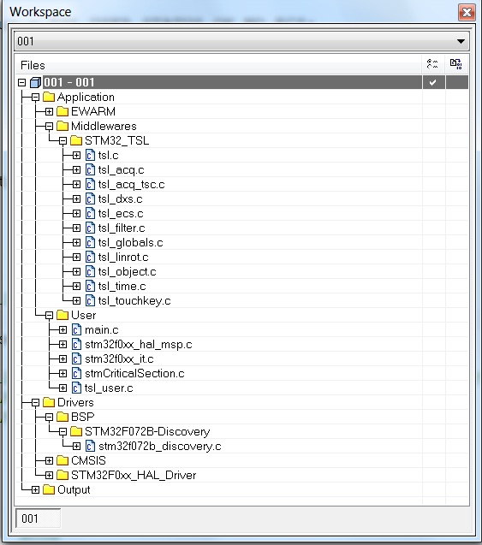
From Scratch
The IDE should be like this:

Slide 74
Demo
The code proposed will:
Blink the orange LED every time the touch sense is detected and will be held ON while the key is pressed
The blink speed for the green LED will change in the same rate the slider is touched
To monitor this code, will verify the following members:
MyLinRots[0].p_Data->StateId
The acceptable values are:
TSL_STATEID_DETECT
TSL_STATEID_DEB_RELEASE_DETECT
For the slider position, will use this:
MyLinRots[0].p_Data->Position (this go from 0 up to 0xF)

Slide 75
From Scratch
Edit main.c
/* USER CODE BEGIN Includes */
#include "main.h"
/* USER CODE END Includes */
/* Private variables ---------------------------------------------------------*/
#define LINEAR_DETECT ((MyLinRots[0].p_Data->StateId == TSL_STATEID_DETECT) || \
(MyLinRots[0].p_Data->StateId == TSL_STATEID_DEB_RELEASE_DETECT))
#define LINEAR_POSITION (MyLinRots[0].p_Data->Position)
/* USER CODE END PV */
/* Private function prototypes -----------------------------------------------*/
static void Error_Handler(void);
static void Process_Sensors(tsl_user_status_t status);
/* USER CODE END PFP */

Slide 76
From Scratch
Edit main.c
/* USER CODE BEGIN 1 */
tsl_user_status_t tsl_status;
/* USER CODE END 1 */
/* USER CODE BEGIN 2 */
/* Initialize the STMTouch driver */
tsl_user_Init();
/* USER CODE END 2 */

Slide 77
From Scratch
Edit main.c
/* USER CODE BEGIN WHILE */
while (1)
{
/* USER CODE END WHILE */
/* USER CODE BEGIN 3 */
/* Execute STMTouch Driver state machine */
tsl_status = tsl_user_Exec();
if (tsl_status != TSL_USER_STATUS_BUSY)
{
Process_Sensors(tsl_status);
}
}
/* USER CODE END 3 */

Slide 78
From Scratch
Edit main.c
void Process_Sensors(tsl_user_status_t status)
{
if (LINEAR_DETECT)
{
BSP_LED_On(LED4);
}
else
{
BSP_LED_Off(LED4);
}
}

Slide 79
From Scratch
Edit main.c
void User_Tick_Management(void)
{
static uint32_t tempo_50ms=0;
static uint32_t tempo_100ms=0;
static uint32_t tempo_200ms=0;
static uint32_t tempo_500ms=0;
tempo_50ms++;
tempo_50ms%=50;
tempo_100ms++;
tempo_100ms%=100;
tempo_200ms++;
tempo_200ms%=200;
tempo_500ms++;
tempo_500ms%=500;
if (LINEAR_POSITION < 4)
{
if (tempo_500ms==0)
{
BSP_LED_Toggle(LED5);
}
}
else if (LINEAR_POSITION < 8)
{
if (tempo_200ms==0)
{
BSP_LED_Toggle(LED5);
}
}
else if (LINEAR_POSITION < 12)
{
if (tempo_100ms==0)
{
BSP_LED_Toggle(LED5);
}
}
else
{
if (tempo_50ms==0)
{
BSP_LED_Toggle(LED5);
}
}
}

Slide 80
From Scratch
Edit main.c
static void Error_Handler(void)
{
/* User may add here some code to deal with this error */
while(1)
{
BSP_LED_Toggle(LED3);
HAL_Delay(200);
}
}
/* USER CODE END 4 */

Slide 81
From Scratch
Edit stm32f0xx_it.c
/* USER CODE BEGIN 0 */
#include "main.h"
/* USER CODE END 0 */
/* USER CODE BEGIN SysTick_IRQn 1 */
TSL_tim_ProcessIT(); /* Used by the STMTouch driver for ECS and DTO */
User_Tick_Management();
/* USER CODE END SysTick_IRQn 1 */

Slide 82

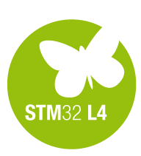



Thank you
/STM32
@ST_World
st.com/e2e
www.st.com/stm32f0

